Slide 1
Gym Database
Elizabeth Beisert, Alexander Sou, Junaid Hashmi, Kevin Chen

Slide 2

The Gymnasium
https://www.shutterstock.com/video/clip-5918108-portrait-multi-ethnic-yoga-class-fitness-studio-gym

Slide 3
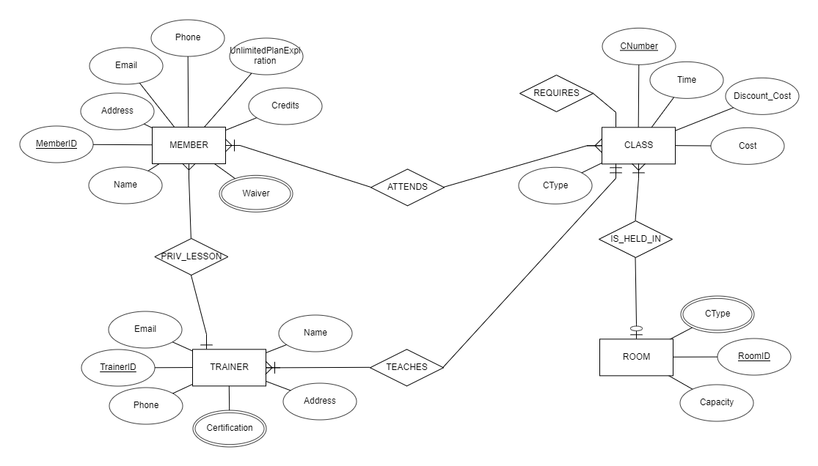
Data Model

Slide 4
Data Model Continued
Member - holds basic personal information and how many class credits a member has; members may have a waiver keeping them from certain activities
Trainer - employees who teach the various classes offered at the gym and may or may not be personal trainers for members; trainers must be certified for any class they teach or to give personal training

Slide 5
Data Model Continued
Room - rooms have capacity and a limit of class type
Class - classes taught by the trainers and attended by members for a certain number of credits

Slide 6
Transactions
Our original plan -
CREDITS - each time a member bought credits or an unlimited plan
REQUIRES - each time a member signs up for a class by making an ATTENDS entity, credits are deducted from one or more CREDITS entities and the relationship between the class and the transaction is recorded
Our final implementation
Credits are an attribute of MEMBER that is updated upon the creation of an ATTENDS entity

Slide 7
Database Demonstration

Slide 8
Conclusion
Overall Experience:
Developing ERD and relation tables trivial
Learning to use MySQL and setting it up difficult
What we Learned:
Acquainted with the basics of the SQL language
Applied ERD and relational principles to a real-world database example
Understand how to apply SQL queries to our specific database
Learned how to use MySQL Server and Workbench

Slide 9

Further Development

Slide 10
Any Questions?

